Slide 1
What is it?
It built the Great Wall of China and helped turned New York into America’s biggest city. Without it, civilizations would never have thrived and technology would be stuck in the Stone Age. It launched wars and sparked revolutions all because humans can’t survive without it. You will learn about how it first formed and the way our very thoughts are made of this valuable resource as you take a tour through space and time, across continents and up through the present.

Slide 2
The Superpower of Salt
Big History from the History Channel

Slide 3
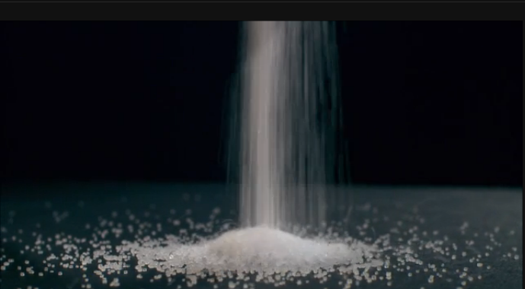
Video Clip Mankind The Story of Us All
http://www.history.com/shows/mankind-the-story-of-all-of-us/videos/salt
Copy and paste the link into chrome and open the video

Slide 4
The Superpower of Salt
Watch the Big History Video “The Superpower of Salt.
Disc 1 #1 (Fast forward past previews if they come up.)

Slide 5
Read the information Day 1
Off the Spice Rack – The Story of Salt
http://www.history.com/news/hungry-history/off-the-spice-rack-the-story-of-salt
The Salt March
www.history.com/topics/salt-march

Slide 6
Salt’s Superpowers Day 1
What is salt and why has it been such an important world resource?
What are some words or phrases in our vocabulary today that are related to salt?
In this episode we learn that “salt draws the world map.” What does this phrase mean and what is one example of how the location of salt has affected the location of a city or highway?
Why do humans need salt?
Why is salt a “superpower”?
Start a word document and answer the discussion questions in full sentences.
Remember your header.
Save it as Salt’s Superpowers
Discussion Questions
Assessment Day 1

Slide 7
Salt’s Superpowers Day 2
Salt Preserves. This episode explores some of the many ways salt has been used as a preservative in processes like mummification and drying meat. Choose one of these methods of preservation and write a short essay or create a visual presentation about how salt acts as a preservative.
Salt Revolutions. Several key turning points in history have been driven by salt taxes, from France to India. Choose one of these events and write a newspaper article or create a presentation depicting why the salt tax drove people to push for political change.
Edible or Non? There are many forms of salt – some are edible and others are not. Create a chart mapping the various forms of salt and their uses.
A World Without Salt. As we learn in this episode, salt is essential to human life. Create a short timeline charting the history of salt and its many uses over time and write a short essay about what the world would be like if salt disappeared.
Choose one of these activities.
Choose a document type that is appropriate for the activity chosen.
Create a header.
Save it as Salt’s Superpowers Day 2
Do the activity.
Activities
Assessment Day 2

